Slide 1

Quality Assessment

Slide 2

Quality
Assessment
Guide

Slide 3
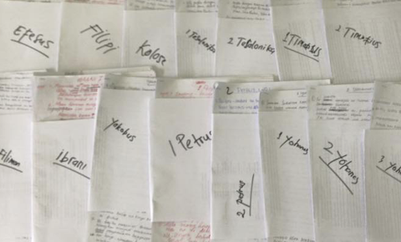






Is it ready?
Keyword Check
Self-edit
Peer-edit
Quality
Naturalness
Standard
Local Church

Slide 4

Globally Accepted Qualities

Slide 5

What makes a good translation?

Slide 6
Quality Assessment Guide
Qualities
Definitions
Questions
Accurate
Correct style
Clear
Natural
Faithful
Historical
Grammatically correct
Other qualities
________________
________________
________________
________________
________________
________________
________________
________________
________________
________________
________________
________________
________________
________________
________________
________________

Slide 7
Try it
Build your guide

Slide 8
Globally Accepted Qualities
Qualities
Definitions
Questions
Accurate
Correct style
Clear
Natural
Faithful
Historical
Grammatically correct
Other qualities
________________
________________
________________
________________
________________
________________
________________
________________
________________
________________
________________
________________
________________
________________
________________
________________

Slide 9
Try it
Matthew 1:18–25
How did it go?

